Slide 1
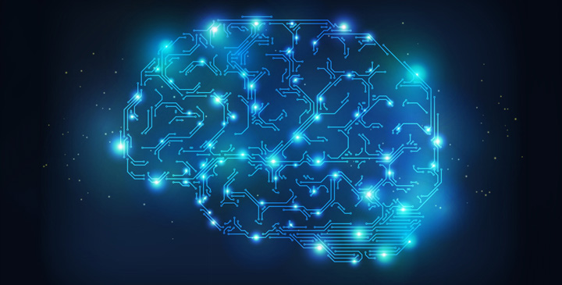
Welcome to Neural Networks

Slide 2
Neural Networks: History
• Artificial Neural Networks (ANN) are a simulation abstract of our nervous system, which contains a collection of neurons which communicate with each other through connections called axons.
• The ANN model has a certain resemblance to the axons and dendrites in a nervous system
• The first model of neural networks was proposed in 1943 by McCulloch and Pitts in terms of a computational model of neural
activity.

Slide 3
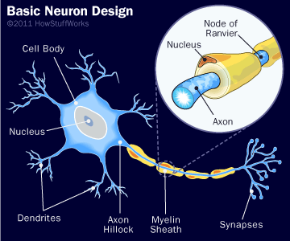
Brain Neurons
Branched extension of a cell nerve i.e. a dendrite receives signal from other neurons via junctions called synapses.

Slide 4
Structure of a Neural Network
• A neural network consists of:
– A set of nodes (neurons) or units connected by links
– A set of weights associated with links
– A set of thresholds or levels of activation
• The design of a neural network requires:
– The choice of the number and type of units
– The determination of the morphological structure (layers)
– Coding of training examples, in terms of inputs and outputs
from the network
– The initialization and training of the weights on the
interconnections through the training set

Slide 5
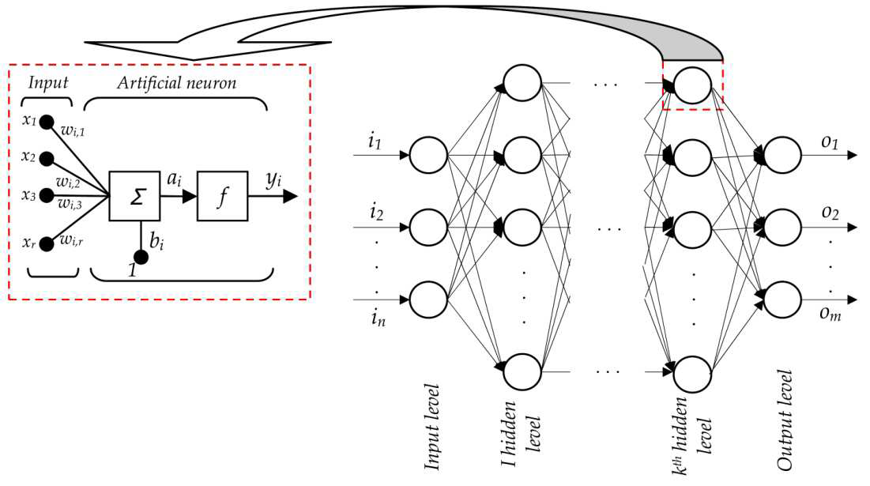
Multi Layer Network

Slide 6
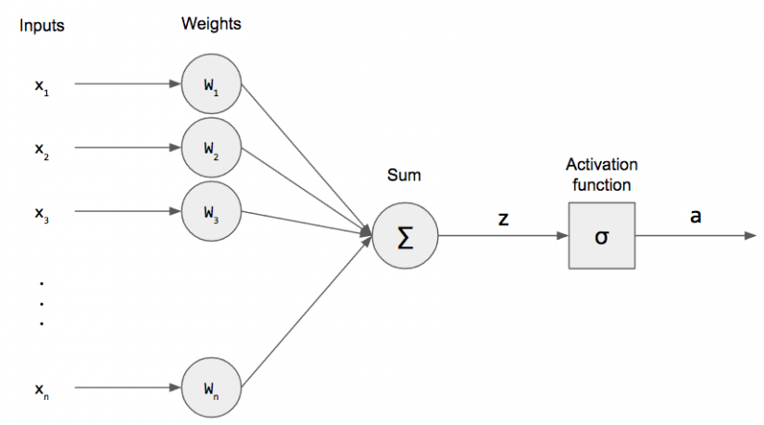
Perceptron
• The output values are Boolean: 0 or 1
• The inputs and weights are positive or negative
real values
• Three elements: inputs, sum, threshold
• The learning is to select weights and threshold.

Slide 7
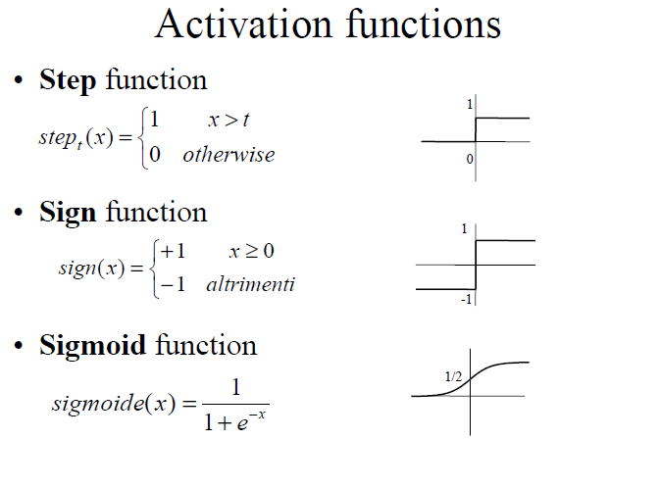

Slide 8
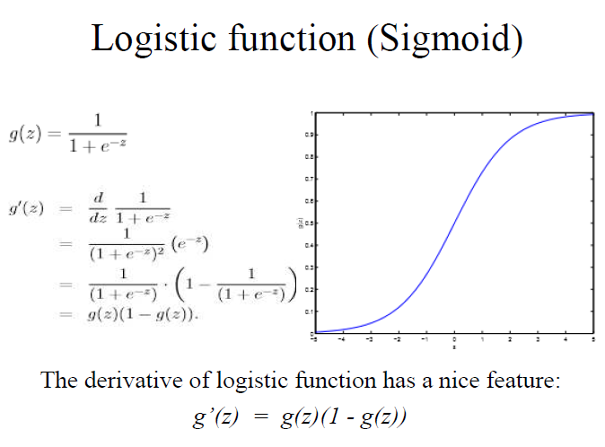

Slide 9
Convolutional Neural Network
A CNN consists of an input and an output layer, as well as multiple hidden layers. The hidden layers of a CNN typically consist of convolutional layers, pooling layers, fully connected layers and normalization layers.
It differs from regular neural networks in terms of the flow of signals between neurons

Slide 10
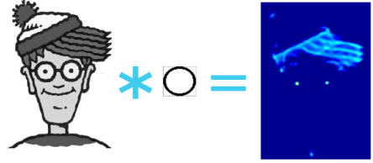
Steps of CNN
Convolution
Convolution is a process where the network tries to label the input signal by referring to what it has learned in the past.
Example: Convolving Image with a circle filter. The circle filter responds strongly to the eyes.

Slide 11
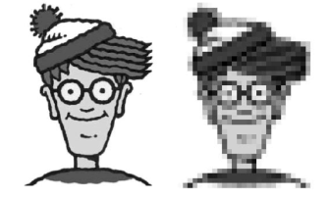
Sub-sampling
- Inputs from the convolution layer can be “smoothened” to reduce the sensitivity of the filters to noise and variations. This smoothing process is called subsampling

Slide 12
Activation
The activation layer controls how the signal flows from one layer to the next, emulating how neurons are fired in our brain. Output signals which are strongly associated with past references would activate more neurons, enabling signals to be propagated more efficiently for identification.

Slide 13
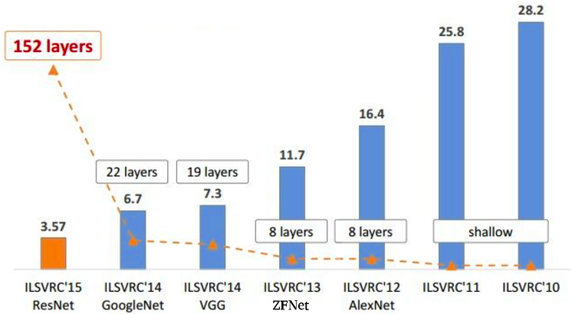
ImageNet Challenge
Use of CNN drastically reduced the error margin to less than human error(5%).

Slide 14
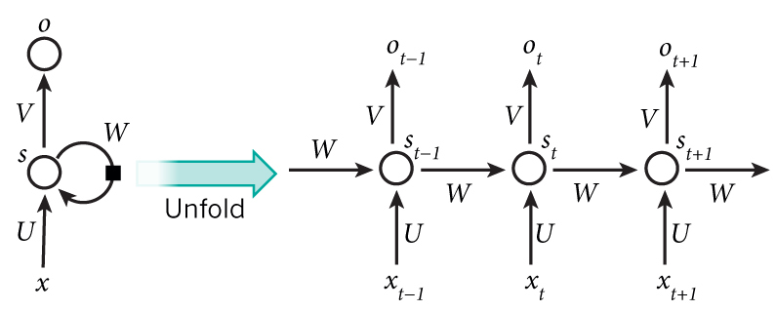
Recurrent Neural Networks
They perform the same task for every element of a sequence, with the output being depended on the previous computations.

Slide 15
Long Short-Term Memory(LSTM)
Long short-term memory (LSTM) units (or blocks) are a building unit for layers of a recurrent neural network(RNN). A RNN composed of LSTM units is often called an LSTM network. A common LSTM unit is composed of a cell, an input gate, an output gate and a forget gate.
Used in large-vocabulary speech recognition and text-to-speech synthesis and was used in Google Android.

Slide 16
Applications of Neural Networks
Speech Recognition
Character Recognition
Face Recognition
Signature verification
Robotics
Financial Predictions

